Slide 1
Data Communication & Internet

Slide 2
Data Communication
Data communications (DC) is the process of using computing and communication technologies to transfer data from one place to another, or between participating parties.
DC enables the movement of electronic or digital data between two or more network nodes, regardless of geographical location, technological medium or data contents.

Slide 3
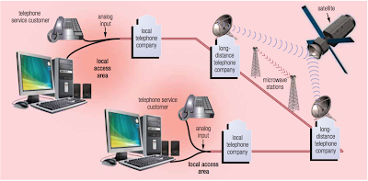
Communication over Telephone Network
The public switched telephone network (PSTN) is the worldwide telephone system that handles voice-oriented telephone calls. Nearly the entire telephone network today uses digital technology, with the exception of the final link from the local telephone company to a home, which often is analog.
The telephone network is an integral part of computer communications. Data, instructions, and information are transmitted over the telephone network using dial-up lines or dedicated lines.

Slide 4
Communication over Telephone Network
Dial-Up Lines
A dial-up line is a temporary connection that uses one or more analog telephone lines for communications.
A dial-up connection is not permanent.
Using a dial-up line to transmit data is similar to using the telephone to make a call.
A modem at the sending end dials the telephone number of a modem at the receiving end.
When the modem at the receiving end answers the call, a connection is established and data can be transmitted.
When either modem hangs up, the communications end.
Using a dial-up line to connect computers costs no more than making a regular telephone call.
Computers at any two locations establish an Internet or network connection using modems and the telephone network.

Slide 5
Communication over Telephone Network
Dedicated Lines
A dedicated line is a type of always-on connection that is established between two communications devices (unlike a dial-up line where the connection is reestablished each time it is used). The quality and consistency of the connection on a dedicated line are better than a dial-up line because dedicated lines provide a constant connection.
Five types of digital dedicated lines are
ISDN (Integrated Services Digital Network)
DSL (Digital Subscribers Line)
FTTP (Fiber to the Premises)
T-carrier lines
ATM (Asynchronous Transfer Mode)

Slide 6
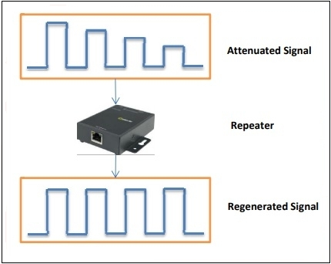
Communication Devices
Repeaters:
Repeaters are network devices operating at physical layer of the OSI model that amplify or regenerate an incoming signal before retransmitting it.
They are incorporated in networks to expand its coverage area.
They are also known as signal boosters.

Slide 7
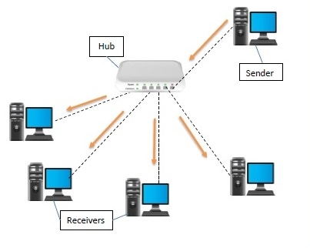
Communication Devices
Hub:
A hub is a physical layer networking device which is used to connect multiple devices in a network. They are generally used to connect computers in a LAN.
A hub has many ports in it. A computer which intends to be connected to the network is plugged in to one of these ports

Slide 8
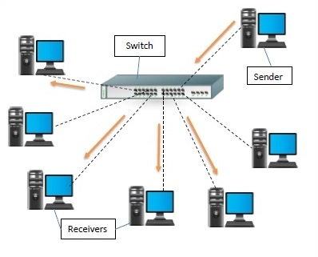
Communication Devices
Switch:
A switch is a data link layer networking device which connects devices in a network and uses packet switching to send and receive data over the network.
Like a hub, a switch also has many ports, to which computers are plugged in

Slide 9
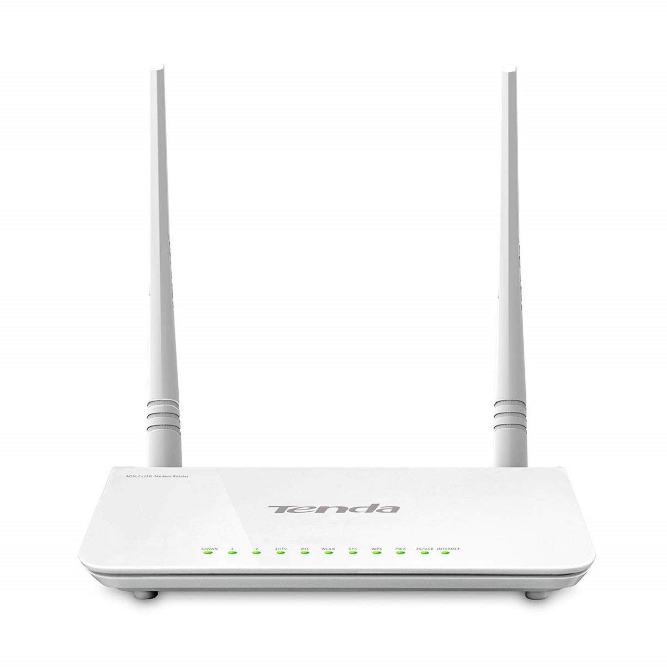
Communication Devices
Modem:
Modem is a device that enables a computer to send or receive data over telephone or cable lines. The data stored on the computer is digital whereas a telephone line or cable wire can transmit only analog data.
Types of Modem:
Simplex − A simplex modem can transfer data in only one direction, from digital device to network (modulator) or network to digital device (demodulator).
Half duplex − A half-duplex modem has the capacity to transfer data in both the directions but only one at a time.
Full duplex − A full duplex modem can transmit data in both the directions simultaneously.

Slide 10
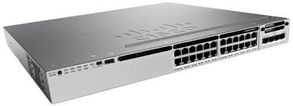
Communication Devices
Routers:
It connects different networks together and sends data packets from one network to another.
A router can be used both in LANs (Local Area Networks) and WANs (Wide Area Networks).
It transfers data in the form of IP packets. In order to transmit data, it uses IP address mentioned in the destination field of the IP packet.
Routers have a routing table in it that is refreshed periodically according to the changes in the network.
Routers provide protection against broadcast storms.
Routers are more expensive than other networking devices like hubs, bridges and switches.
Routers are manufactured by some popular companies like − Cisco, D-Link, Nortal, Juniper, HP etc

Slide 11
The Internet
A network of networks is called an internetwork, or simply the internet.
The internet hugely connects all WANs and it can have connection to LANs and Home networks.
Internet uses TCP/IP protocol suite and uses IP as its addressing protocol.
Internet enables its users to share and access enormous amount of information worldwide.
It uses WWW, FTP, email services, audio and video streaming etc. At huge level, internet works on Client-Server model.
Internet uses very high speed backbone of fiber optics.
To inter-connect various continents, fibers are laid under sea known to us as submarine communication cable.

Slide 12
Internet Browser & Search Engines
Web Browser:
A web browser is a software application for accessing information on the World Wide Web. When a user requests a web page from a particular website, the web browser retrieves the necessary content from a web server and then displays the page on the user's device.
Search Engines:
A web search engine or Internet search engine is a software system that is designed to carry out web search (Internet search), which means to search the World Wide Web in a systematic way for particular information specified in a textual web search query

Slide 13
E-mails & E-Commerce
E-mail:
Electronic mail is a method of exchanging messages between people using electronic devices. Email uses multiple protocols within the TCP/IP suite. For example, SMTP is used to send messages, while the POP or IMAP protocols are used to retrieve messages from a mail server.
E-Commerce:
E-commerce (electronic commerce) is the activity of electronically buying or selling of products on online services or over the Internet. Electronic commerce draws on technologies such as mobile commerce, electronic funds transfer, supply chain management, Internet marketing, online transaction processing, inventory management systems, and automated data collection systems.

Slide 14
Internet Security
Threats
Internet security threats impact the network, data security and other internet connected systems. Cyber criminals have evolved several techniques to threat privacy and integrity of bank accounts, businesses, and organizations.
Following are some of the internet security threats:
Mobile worms
Malware
PC and Mobile ransomware
Large scale attacks like Stuxnet that attempts to destroy infrastructure.
Hacking as a Service
Spam
Phishing

Slide 15
Internet Security
Encryption:
Encryption is a security method in which information is encoded in such a way that only authorized user can read it. It uses encryption algorithm to generate ciphertext that can only be read if decrypted.
Digital Signature:
Digital signatures allow us to verify the author, date and time of signatures, authenticate the message contents.
Firewall:
Firewall is a barrier between Local Area Network (LAN) and the Internet. It allows keeping private resources confidential and minimizes the security risks. It controls network traffic, in both directions.

Slide 16
THE END

